Slide 1
Ruby on Rails
Web Application Framework
Notes:
Entered text
Server Components

Slide 2

Ruby on Rails
Web application framework
Model-View-Controller (MVC) architecture
Convention over Configuration - write configuration only for deviations
Don't Repeat Yourself (DRY)
SOLID object oriented design principles
Easy to setup and build prototypes
Active developer community
Usage:
Airbnb
GitHub
Shopify
Hulu

Slide 3
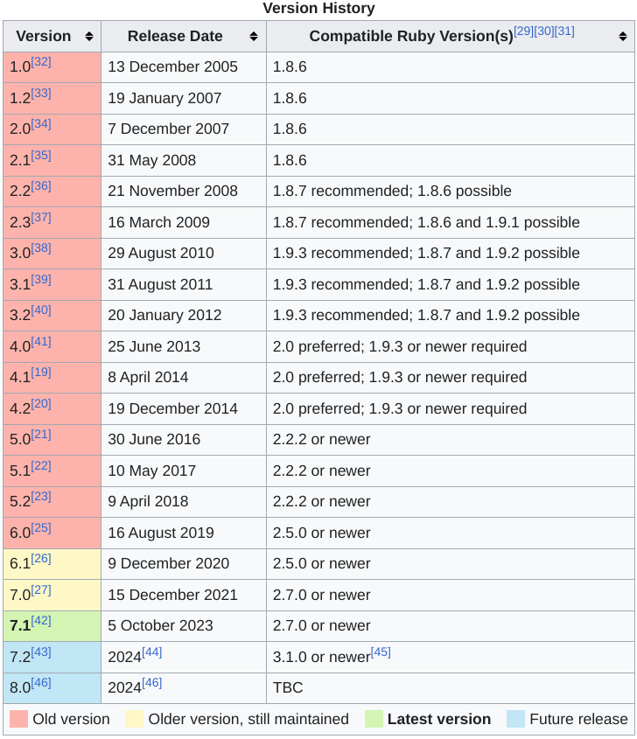
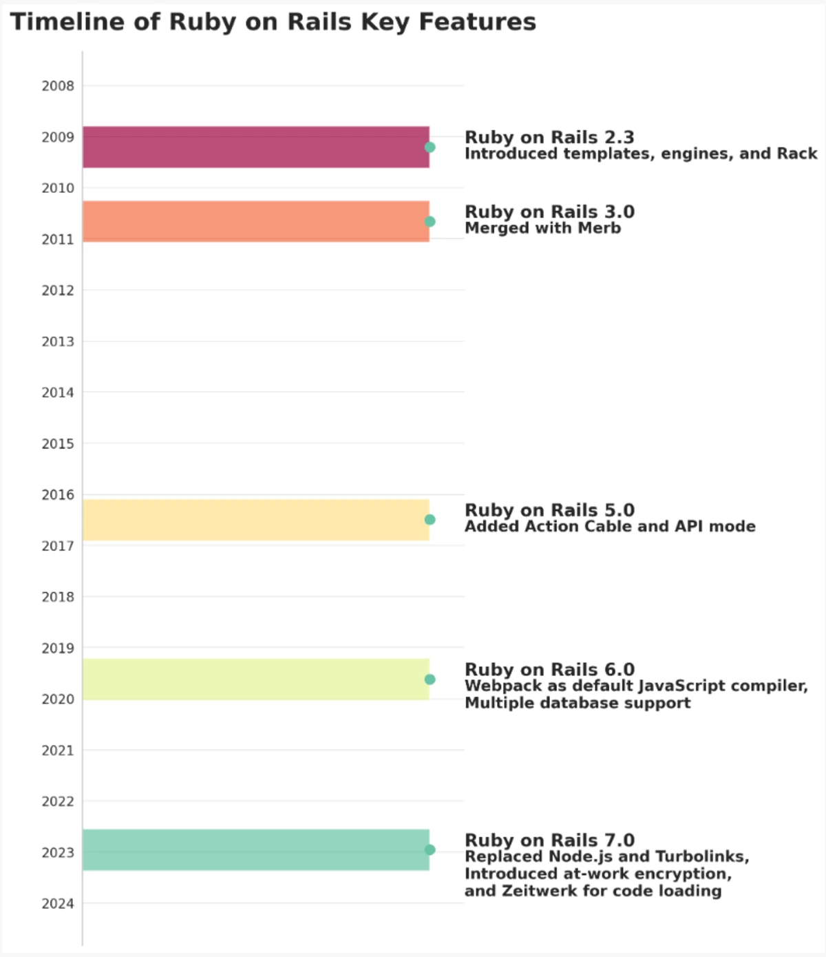
History

Slide 4
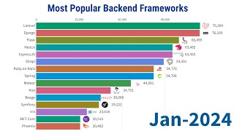
Popularity

Slide 5
SOLID
Single Responsibility Principle
Сlass should have only one reason to change
Class should have only one job or responsibility
Open/Closed Principle
Abstraction should be open for extension but closed for modification
Liskov Substitution Principle
Objects of a superclass should be replaceable with objects of a subclass
Interface Segregation Principle
Interfaces should be splitted if not fully used
Dependency Inversion Principle
High-level modules should not depend on low-level modules
Abstractions should not depend on details. Details should depend on abstractions.

Slide 6
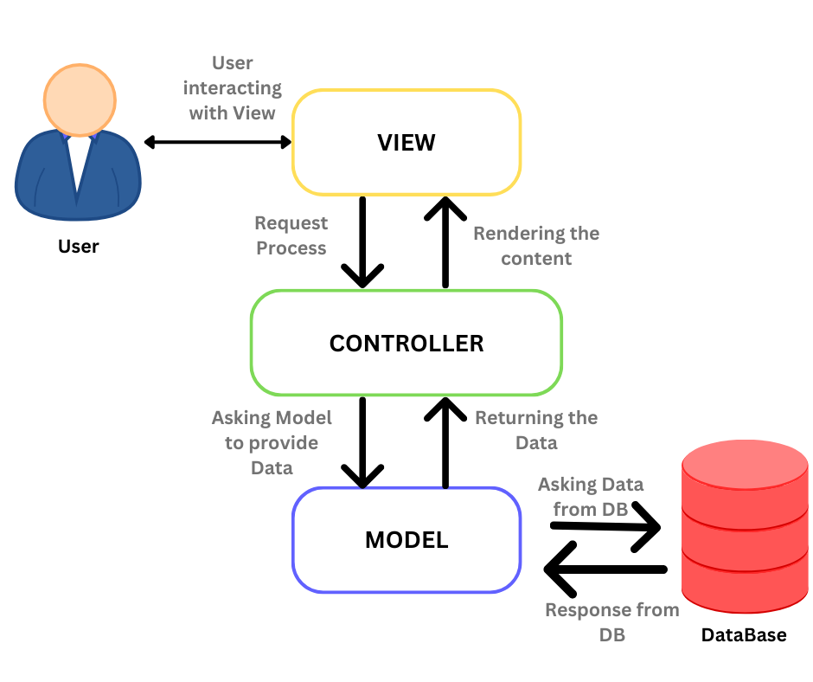
Model-View-Controller
Software design pattern
Model - date representation
View - user interface
Controller - intermediate logics

Slide 7
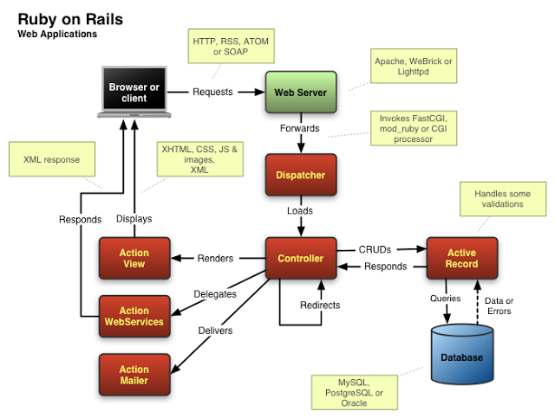
Rails Architecture
Application Server
Loader
Rack Middlewares
Routing
Controller
Model
View
Mailer

Slide 8
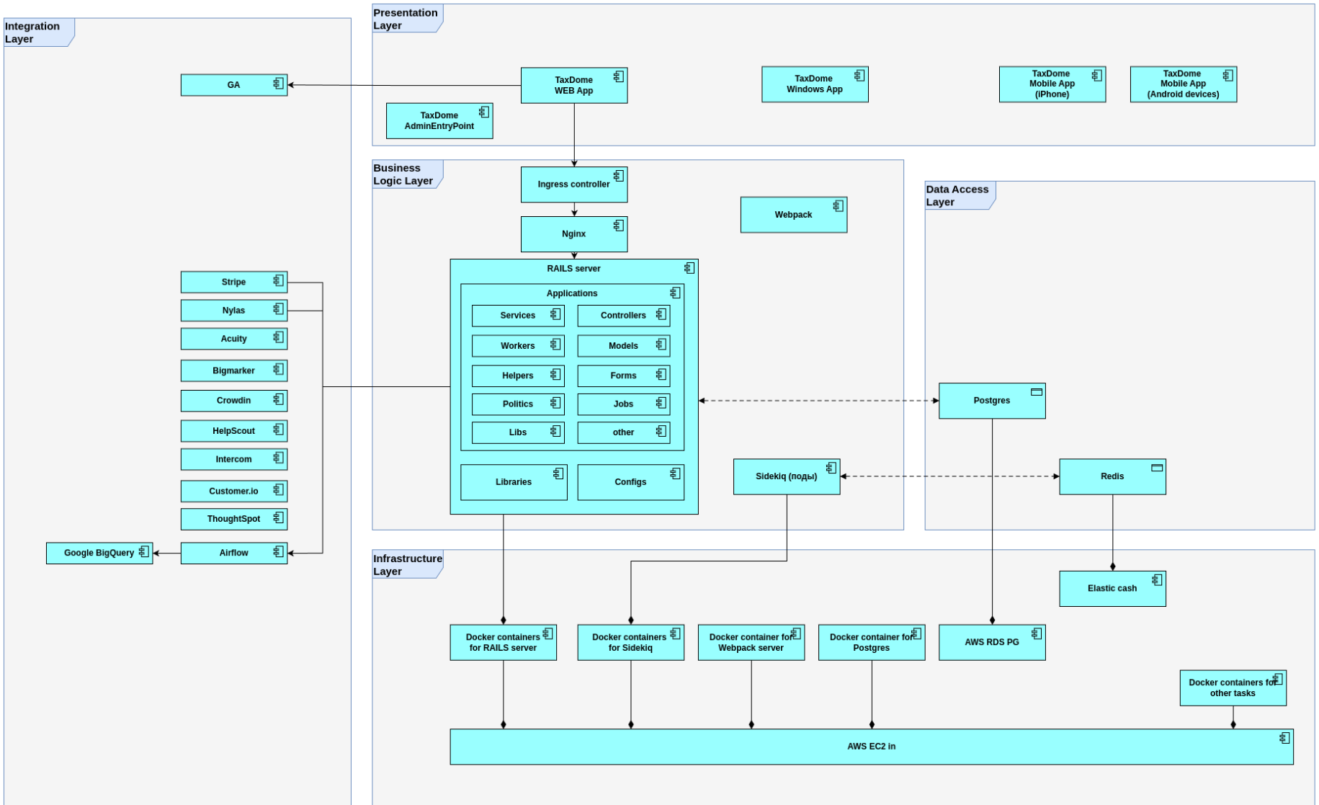
TaxDome Architecture

Slide 9
Rails Components
Migrations (ActiveRecord::Migration)
Models (ActiveRecord)
Routes (ActionDispatch)
Controllers (ActionController)
Services
Views
Serializers (ActiveModel::Serializer)
Mailers (ActionMailer)
Workers (Sidekiq::Worker)
Helpers/Lib

Slide 10
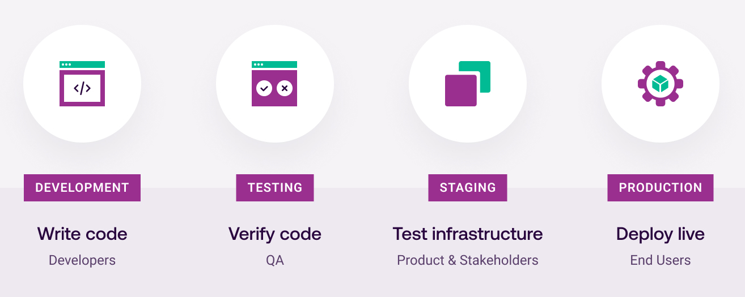
Environments
App runs in different environments
Each has different ENV variables
Test
Running autotests
Has separate database
Development
Local development
Debugging and logging
Dynamic code reloading
Staging
Running live code on staging
Staging integrations
Production
Running live code on staging
Production integrations
More resources and scalability

Slide 11
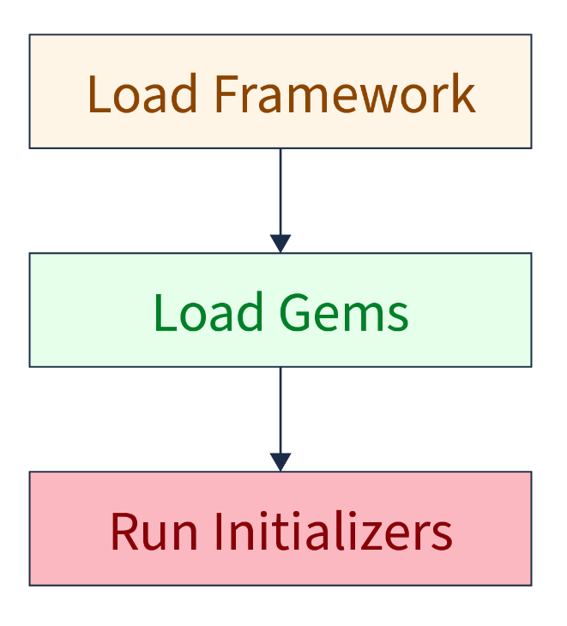
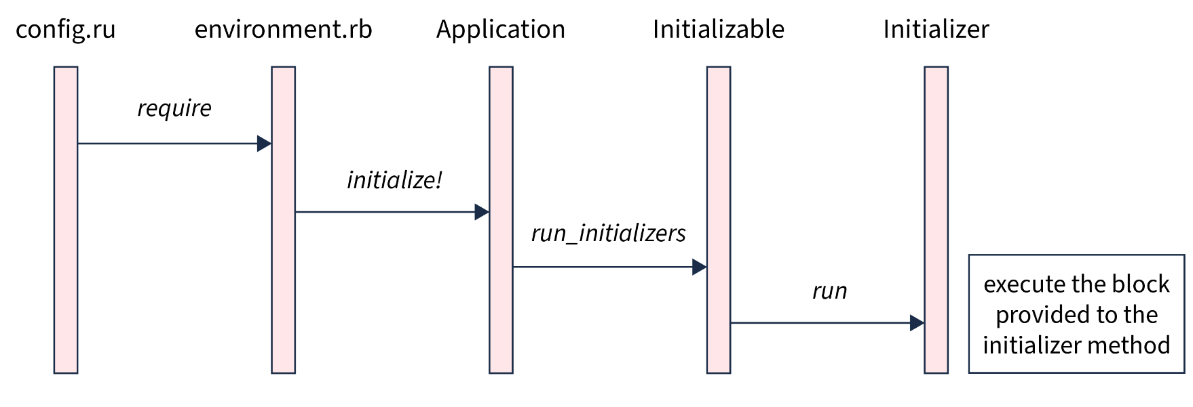
Initializers
Scripts that run during the boot of Rails
Loaded after the framework and gems, but before the application
Use cases:
Set up configuration settings for libraries
Customize framework defaults
Initialize global settings

Slide 12
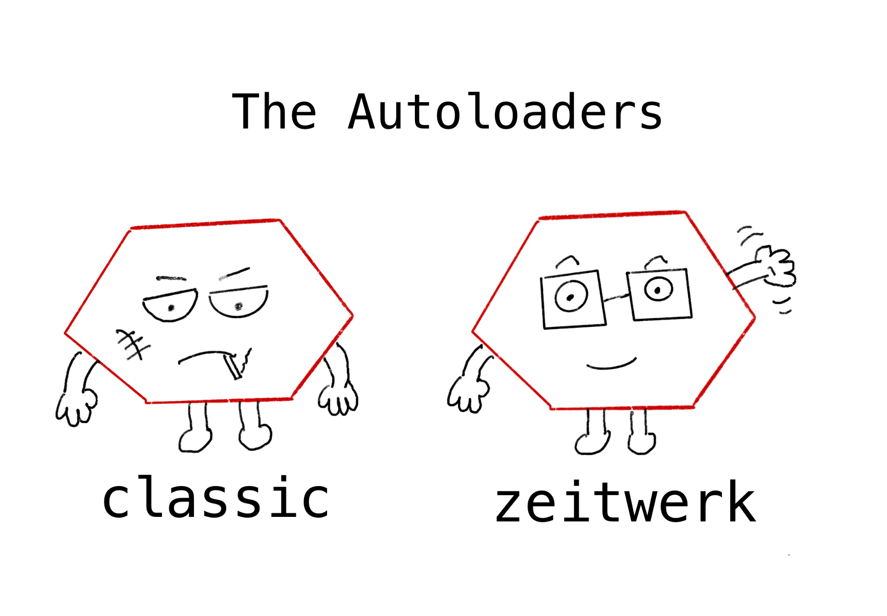
Loader
Rails 6 introduced Zeitwerk Autoloader
Has eager and lazy loading modes
Maps file paths to constant names
Improved performance
Faster update on code change
Enforces code and file structure

Slide 13
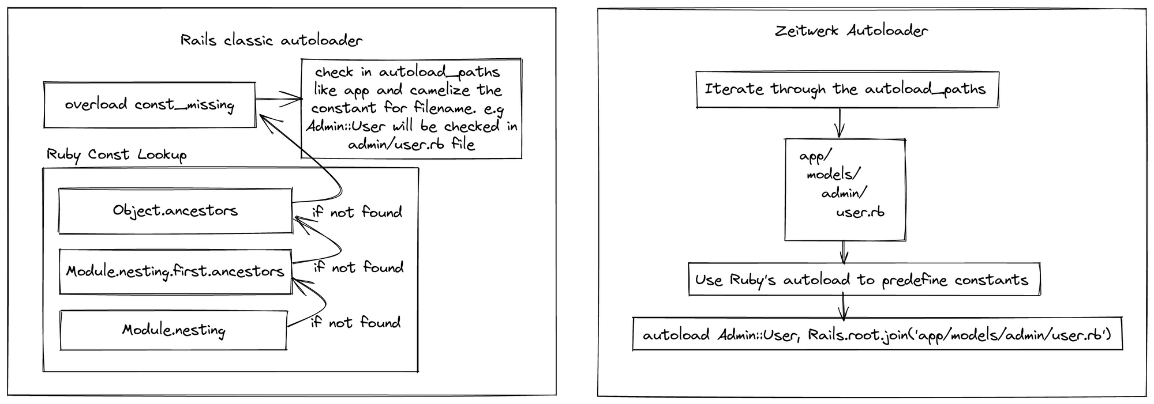
Loader

Slide 14
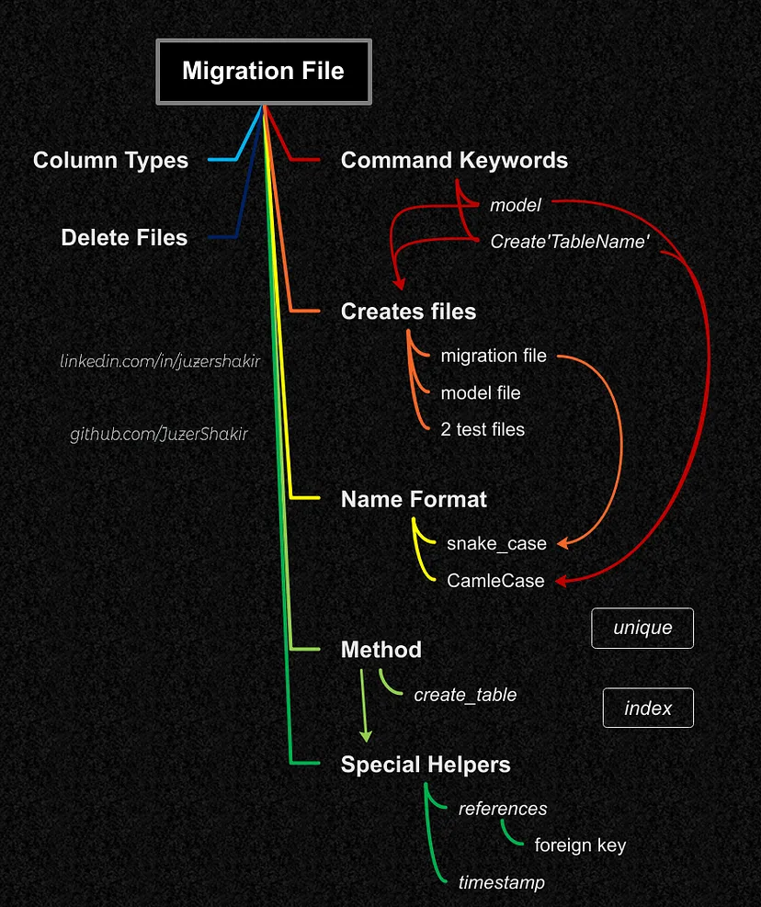
Migrations
Transformations database structure without SQL
SQL Methods:
create/change/rename/drop table
add/remove/rename column
add/remove/rename index
Helper Methods:
timestamp
references
Column Types:
binary, boolean
date, datetime
decimal, float, integer, bigint
primary_key, string, text, enum
time, timestamp

Slide 15
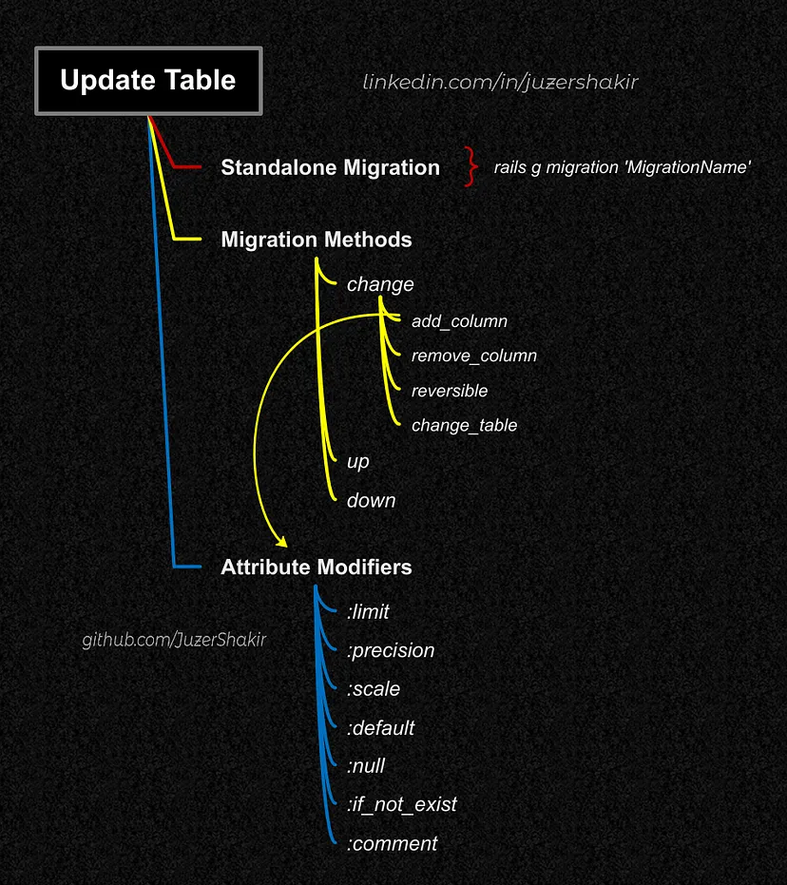
Migrations
Options:
collation
limit
default
null
precision, scale
Revertable:
change
up
down

Slide 16
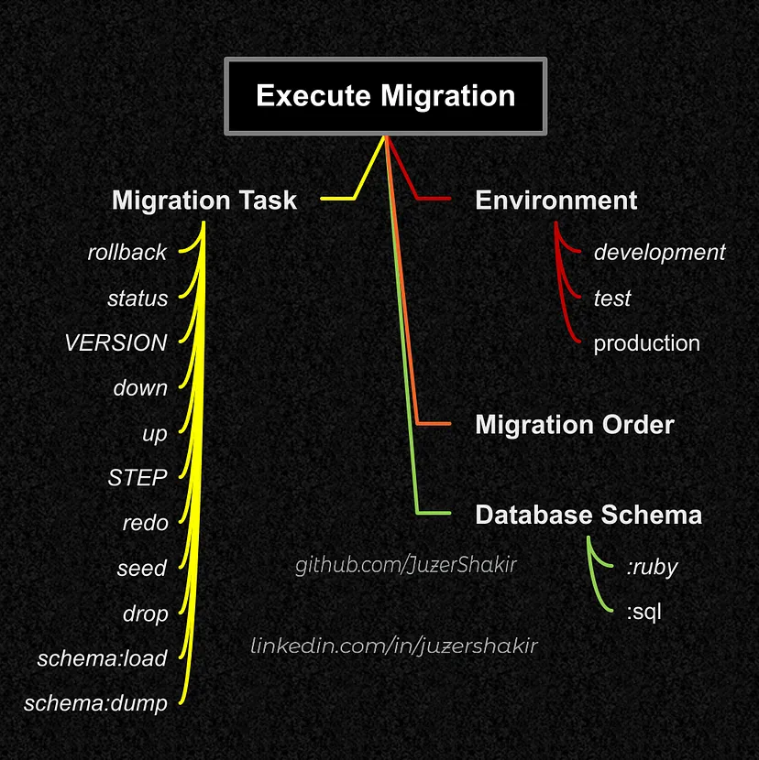
Migrations
Schema reflects the current state of the database
System evolves in incremental steps
Enables version control
Commands:
db:migrate/rollback[VERSION,STEP]
db:migrate:status
db:migrate:up/down[VERSION]
db:rollback:redo[VERSION,STEP]
db:seed
db:drop
db:schema:load/dump

Slide 17
Data Migrations

Slide 18
Seeds

Slide 19
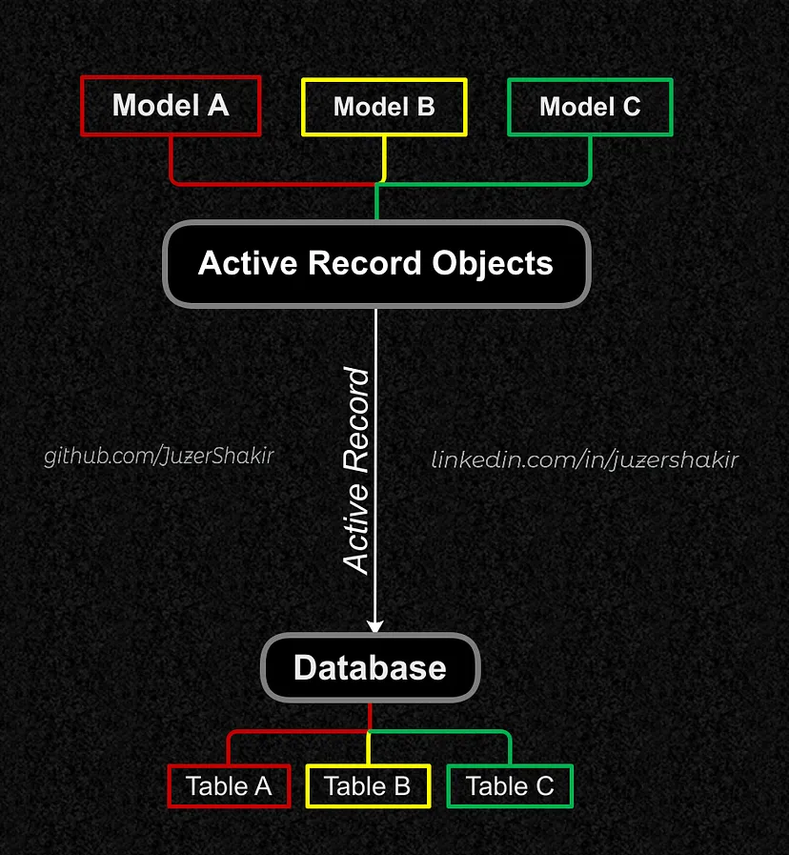
ORM
Object-Relational Mapping (ORM) converts data between OOP and databases
Two Main Patterns: Active Record and Data Mapper
ActiveRecord is the default Rails ORM
Each database table corresponds to a class
Each record in the table is represented by an instance of the class

Slide 20
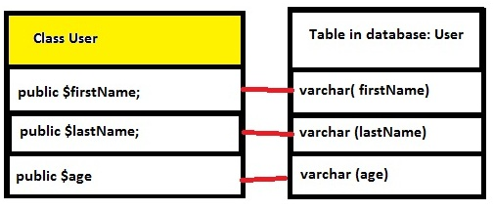
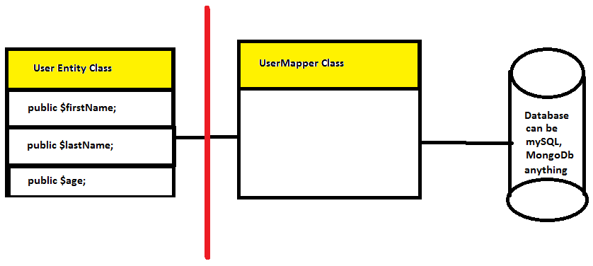
Active Record vs Data Mapper
Each model class corresponds directly to a database table
Can lead to bloated models with mixed responsibilities
Tight coupling between model and database schema
Models are plain objects with no knowledge of the database.
A separate mapper class handles database interactions.
Clear separation of concerns
Increased complexity

Slide 21
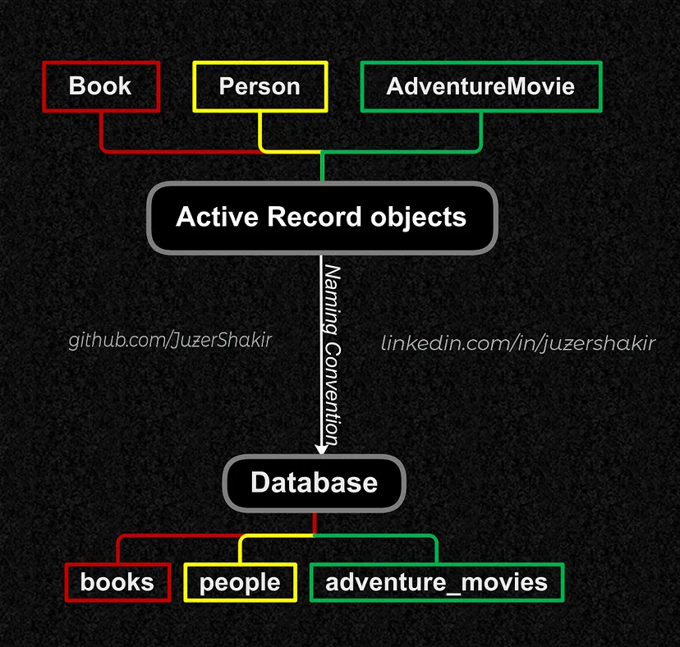
Models
Provide an interface between tables in the database and Ruby code to modify or create attributes and instances of a table
Class Methods:
new/create
update_all
where/all/find/find_by
destroy_by/destroy_all
Instance Methods:
update
destroy

Slide 22
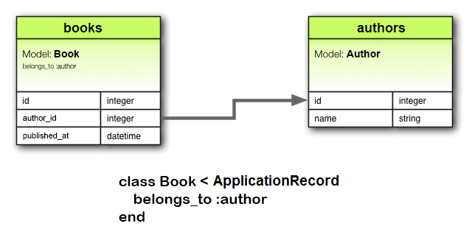
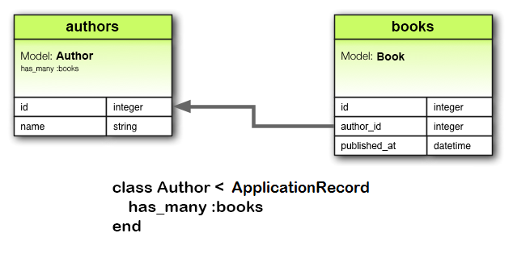
Associations
Associations establish relationships between models
Associations:
belongs_to
has_one/many
has_one/many_through
Has eager loading (includes)
Allows polymorphic associations
Methods:
create_x
build_x
x_changed?

Slide 23
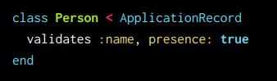
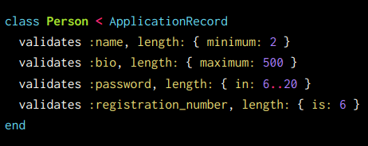
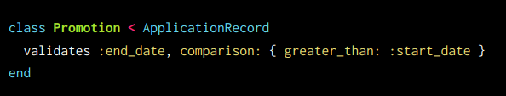
Validations
Ensure that only valid data is saved
Types:
acceptance
confirmation
comparison
format
inclusion
exclusion
length
numericality
presence
absence
uniqueness
validates_associated
validates_each
validates_with

Slide 24
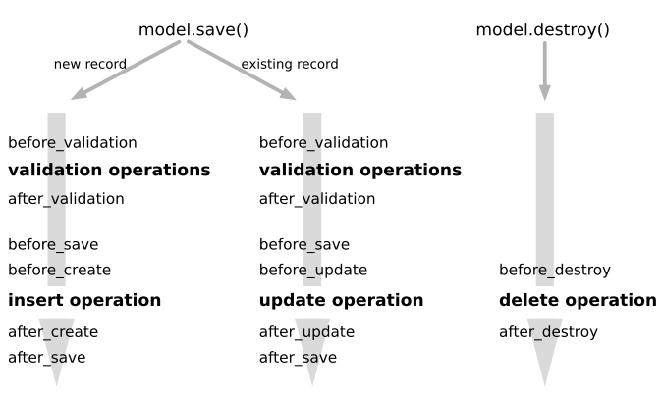
Callbacks

Slide 25
Scopes

Slide 26
Store Model

Slide 27
AASM

Slide 28
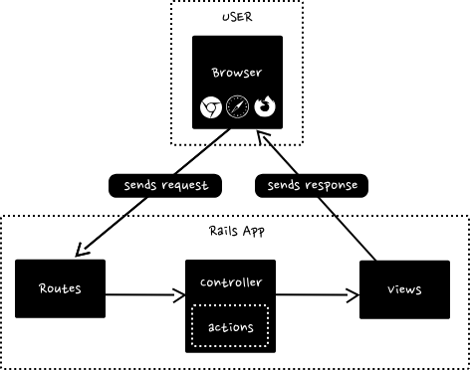
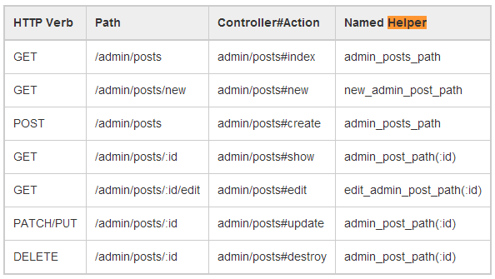
Routers
Handles URL requests and directs them to the appropriate controller actions
Layers:
namespace
scope
resource
Custom Actions:
member
collection

Slide 29
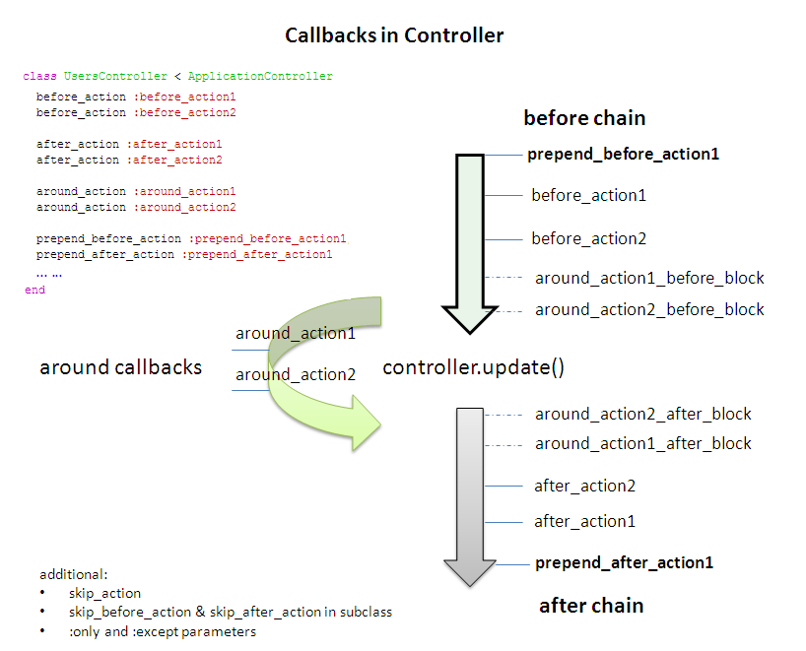
Controllers
Handle incoming web requests and return responses
ActionController::Parameters handles params
Has callbacks
Controls response format
Delegates:
params validations -> FormObject
complex logics -> ServiceObject
complex queries -> QueryObject
access restriction -> Policy
response format -> Serializer

Slide 30


Slide 31
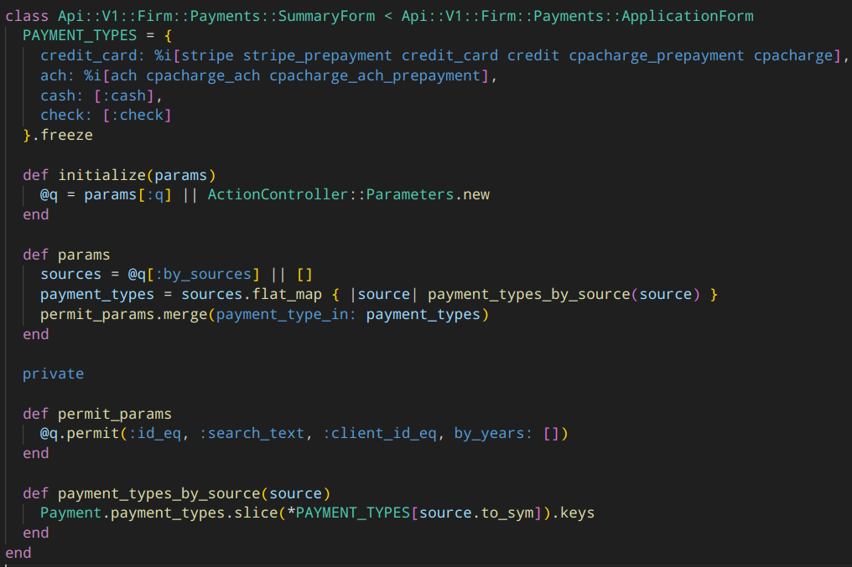
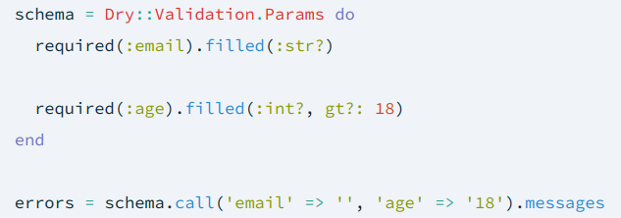
Forms
Keeps models clean by moving form-related logic to a separate object
Located in app/forms
Handles forms that interact with multiple models or have complex validation rules
Loose coupling
Implementation:
ApplicationForm
dry-rb Form Validation

Slide 32
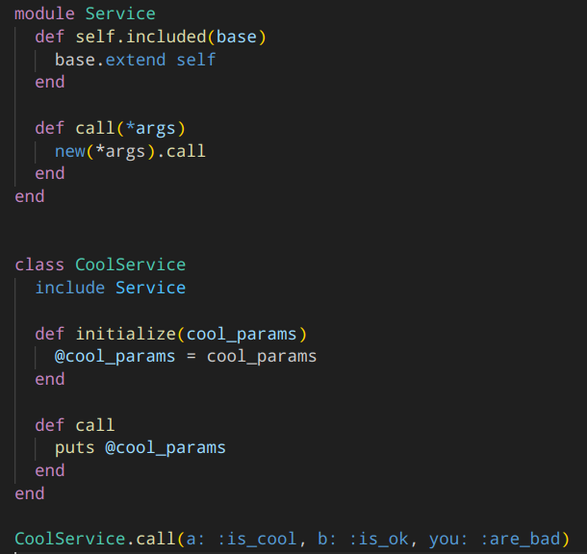
Services
Service objects encapsulate complex business logic
Located in app/services
Each service object has one specific job
Services can be reused
Loose coupling
Must contain constructor and call methods

Slide 33
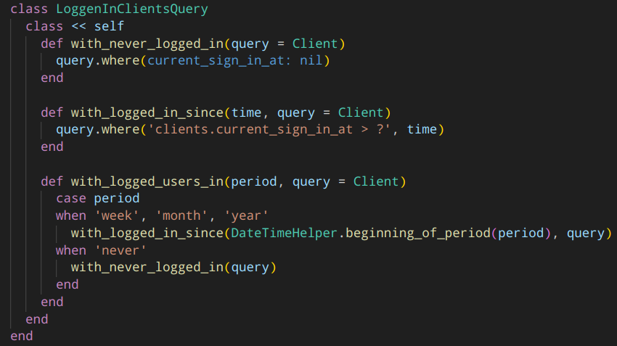
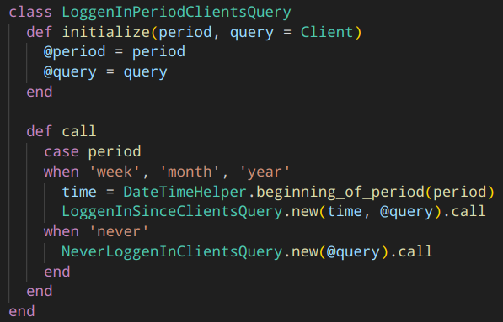
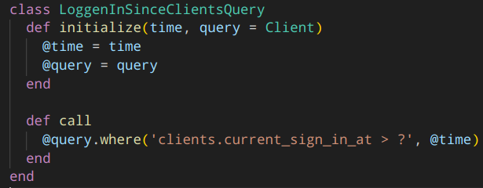
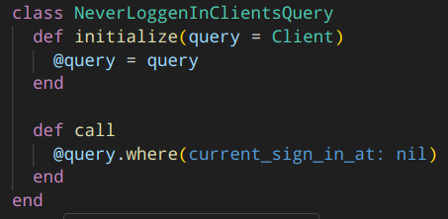
Queries
Encapsulate complex query logic into a reusable object
Located in app/queries
Thin controller, thin model
Loose coupling

Slide 34
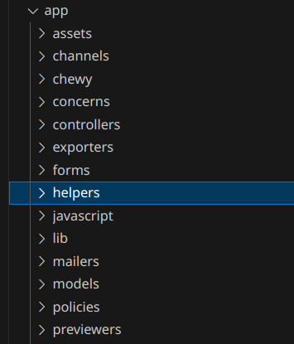
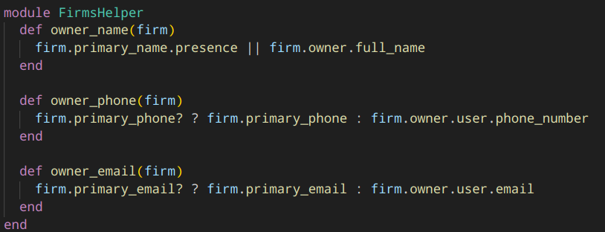
Helpers
Methods that assist in rendering views
Located in app/helpers
Can be included in controllers
Default helper methods:
form_with
fields_for
link_to
image_tag

Slide 35
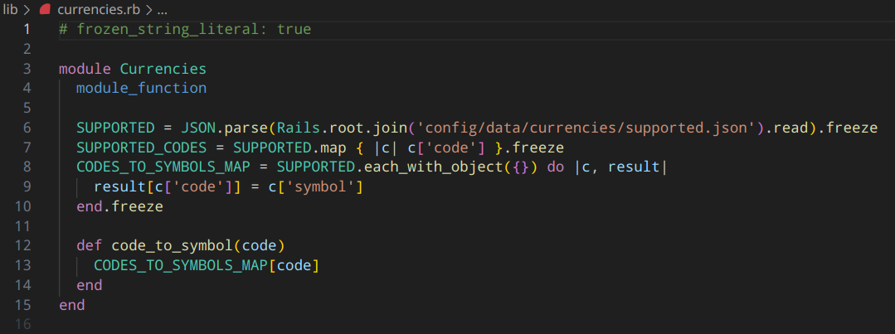
Lib
Custom libraries, modules, and reusable code that do not fit into other patterns
Located in lib
Not autoloaded by default
Examples:
Rake tasks
Monkey patching
Mixins
Middlewares

Slide 36
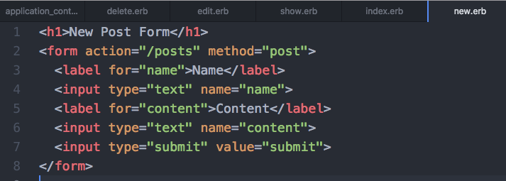
Views
Templates that represent controller data to the user
Located in app/views
Controller renders templates by CoC (can be overridden)
Views can be shared between controllers
Locals support
Rails Helpers integration
Type:
HTML
JSON
XML
Partial

Slide 37
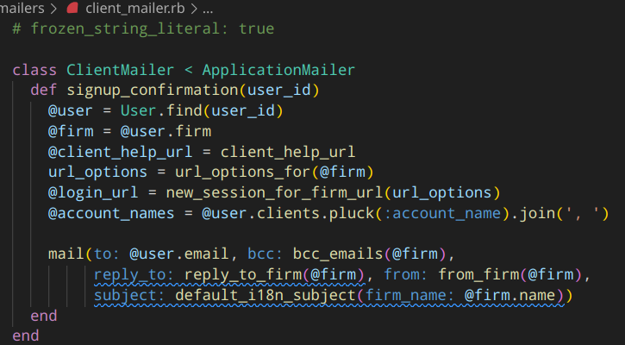
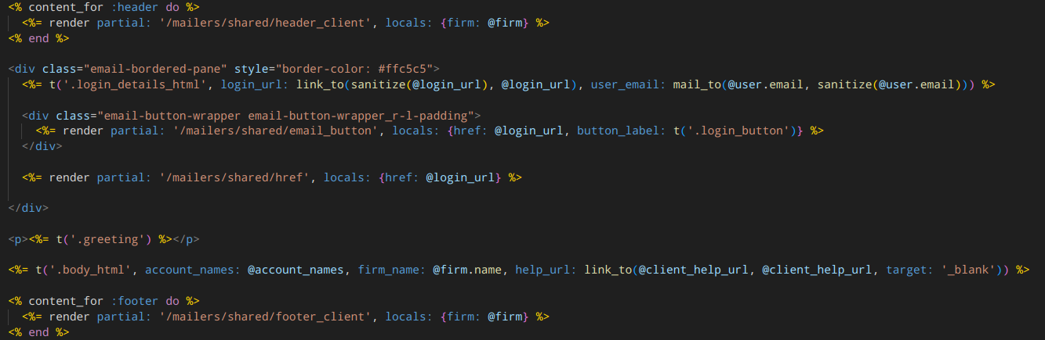
Mailers
Action Mailer is a framework for designing email service
Located in app/mailers and app/views/mailers
Handles the creation and delivery of emails
Consists of mailers and views
Supports locales

Slide 38
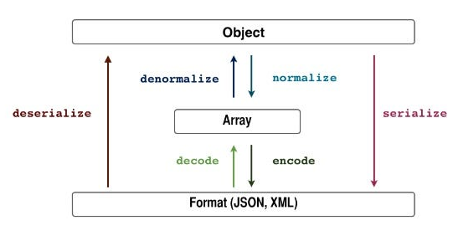
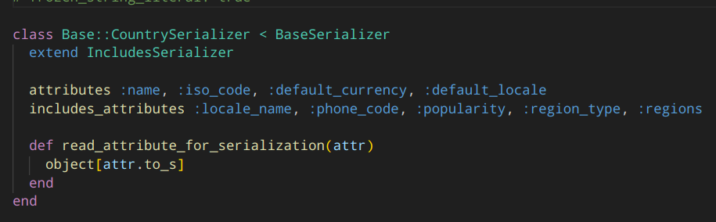
Serializers
Format and structure data when rendering API responses
Located in app/serializers
Supports JSON, JSON-API, XML
Implementations:
ActiveModel::Serializers (AMS)
Fast JSONAPI
Blueprinter
JSONAPI-RB

Slide 39
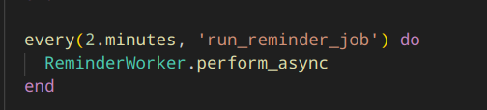
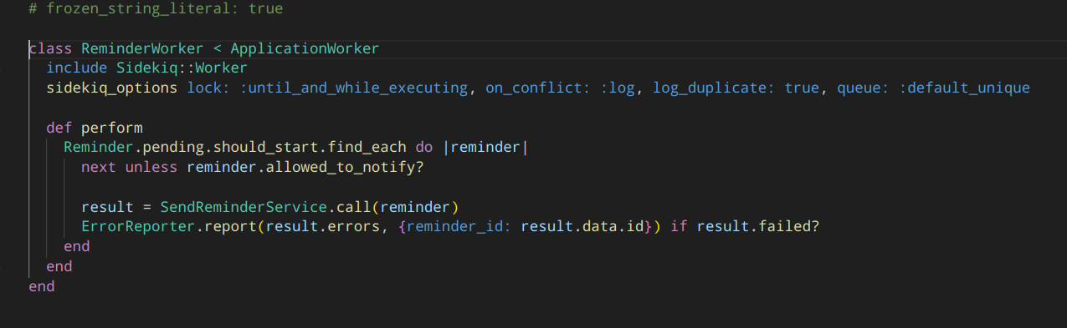
Workers
Workers handle background jobs
Located in app/workers
Clockwork gem manages recurring events
Implementations:
Sidekiq
Rescue
Delayed Job

Slide 40

Thank you for your attention!

